Slide 1

MicroCore Containers
Revolutionising software deployment through lightweight, isolated environments with AI-assisted optimisation
Bishnu Prasad Nayak
Gautam Veer

Slide 2
The Container Challenge
Modern containers like Docker and Podman have transformed deployment, but face critical limitations that impact performance and security.
Large Base Images
Security Exposure
Even minimal images like Alpine carry redundant libraries and utilities not required by all workloads.
Shared kernel access enables privilege escalation and container breakout attacks.
I/O Overhead
Cold Start Latency
Layered union filesystems create performance bottlenecks during intensive operations.
Mounting layers and initialising namespaces impacts microservice scalability.

Slide 3
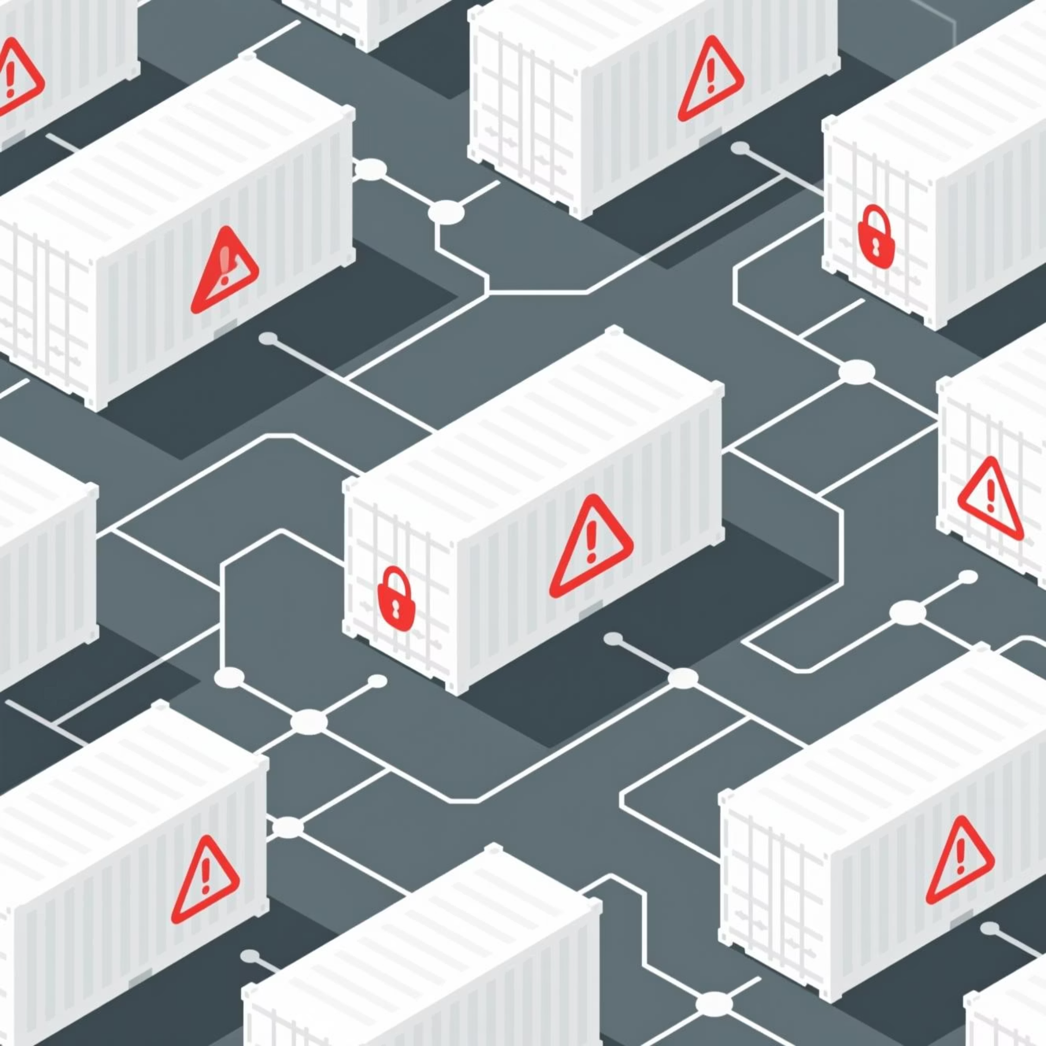
The Problem Statement
Conventional containerisation technologies leverage shared host kernels for process isolation. Whilst efficient compared to virtual machines, this approach introduces unnecessary bloat, security vulnerabilities, and performance degradation.
The need for a more efficient, lightweight, and secure containerisation paradigm is critical for modern microservices.

Slide 4
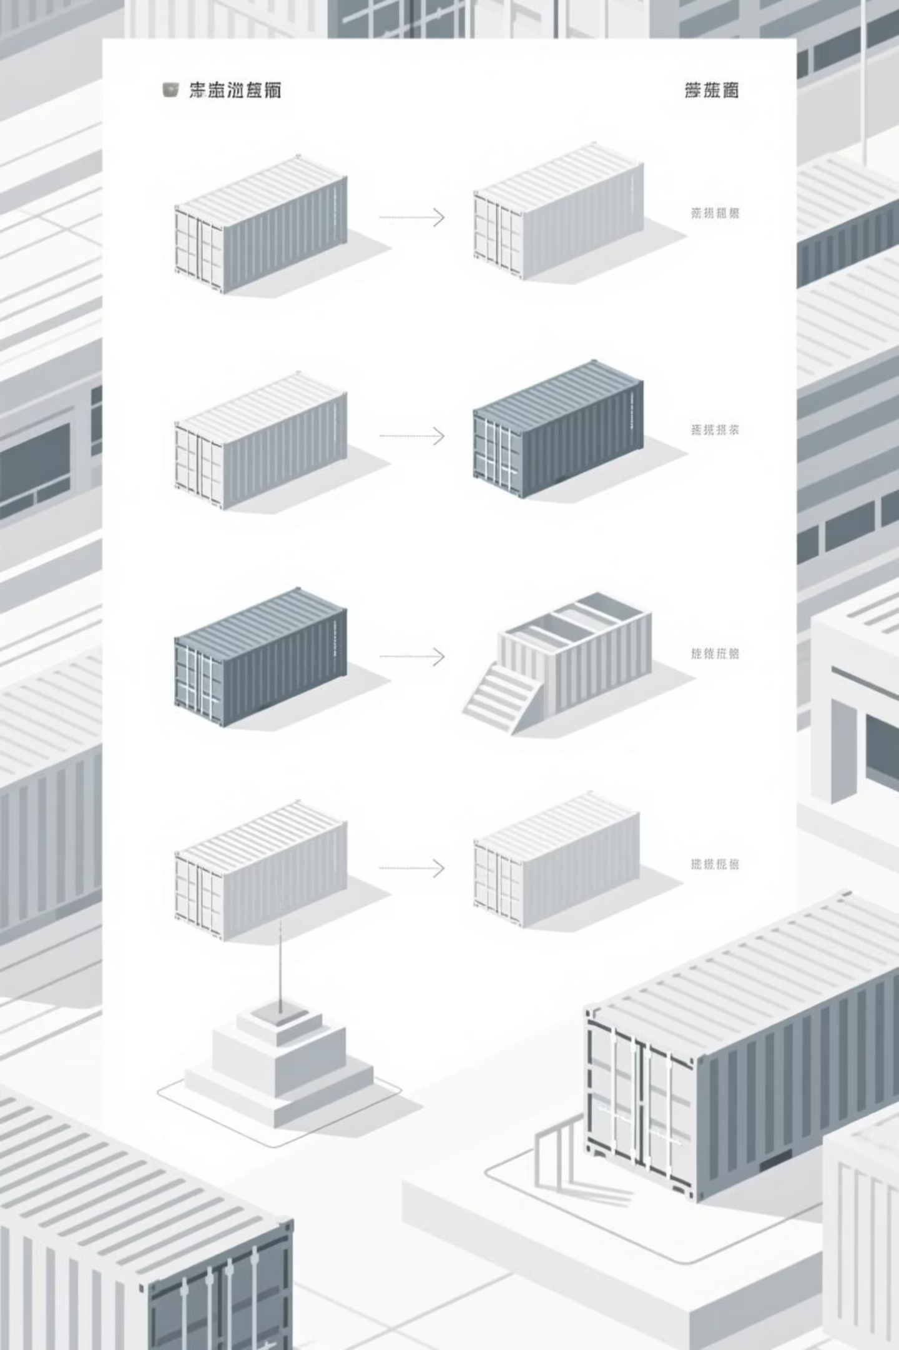
Related Work
Unikernels
gVisor
MirageOS and IncludeOS compile applications into specialised single-purpose machine images. Excellent performance but lack portability and tooling compatibility.
User space kernel intercepting syscalls, providing additional isolation layer.
Image Optimisation Tools
Slim.ai and DockerSlim use static analysis to minimise container images but rely on post-build heuristics rather than runtime intelligence.

Slide 5
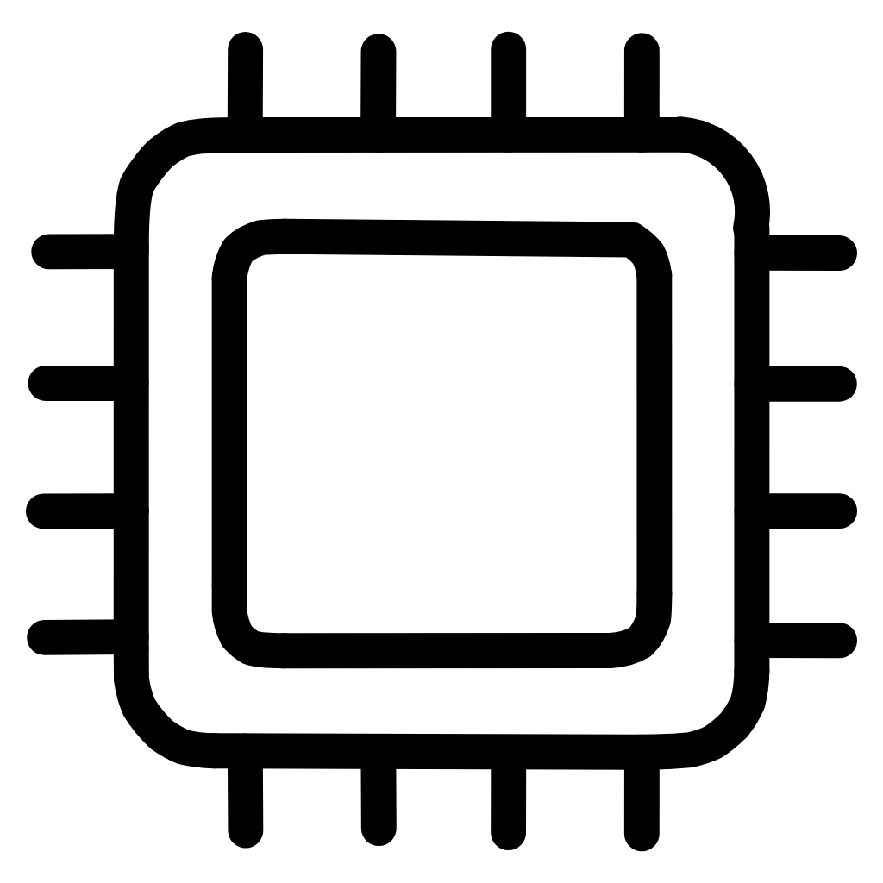


Introducing MicroCore Containers
A novel architecture combining unikernel efficiency with Docker-like flexibility through three revolutionary components.
MicroKernel Runtime Layer
AI-Assisted Image Pruning
Zero-Copy Memory Sharing
Modular runtime providing only essential system calls and drivers. Each container runs atop a customised microkernel module dynamically assembled at launch.
Offline and online toolchain generating minimal image snapshots using static, dynamic analysis, and ML-based prediction of required dependencies.
Cluster-local shared, read-only memory mapping for deduplicated layers and common libraries with Copy-On-Write for mutations.

Slide 6
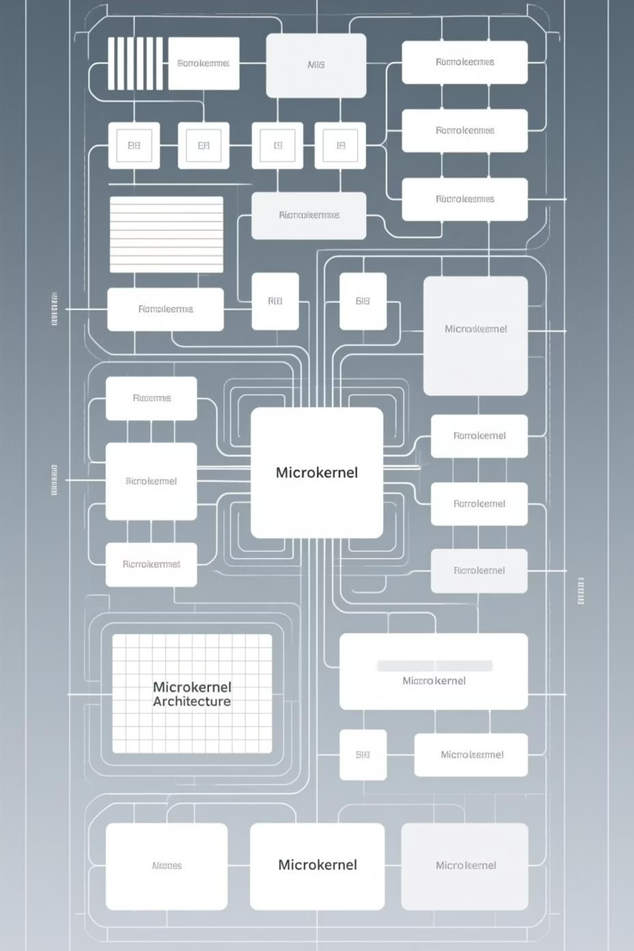



MicroKernel Architecture
Isolated Services
Networking and file I/O run in separate privilege domains, limiting attack surface.
Message Passing
Enforced communication between containers and services rather than direct syscalls.
Modular Loading
On-demand lazy fetching keeps containers ultra-lightweight.

Slide 7
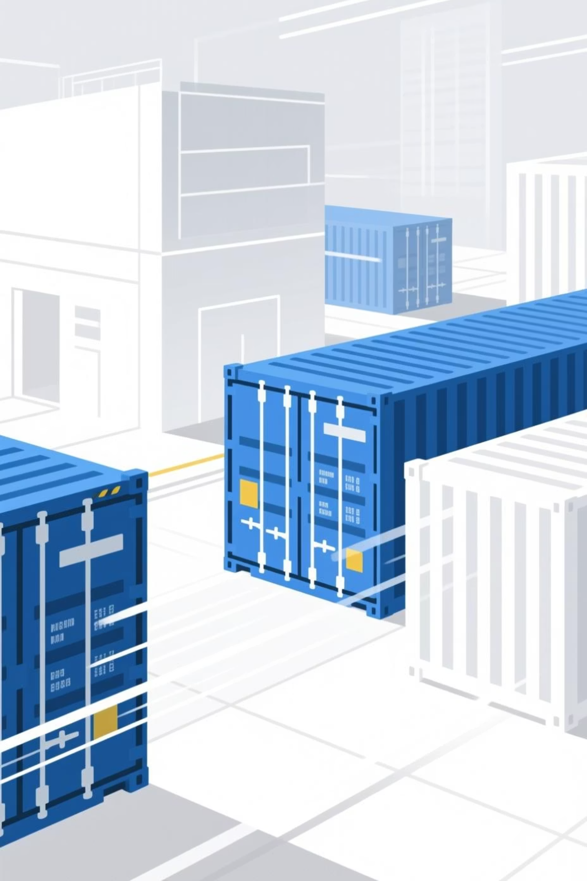
Core Design Goals
01
Fast Startup
Container instances start rapidly with minimal initialisation overhead.
02
Minimal Footprint
Use minimal memory and disk by carrying only what the workload needs.
03
Microkernel Isolation
Isolate services with microkernel-style modularity for enhanced security.
04
OCI Compatibility
Remain compatible with OCI tooling and orchestrators for seamless integration.

Slide 8
Technical Implementation
Container Isolation
MKRL Core Services
Each container runs in its own microdomain with dedicated user space services layer and capability-based access to only required services.
The microkernel exposes only essential functions:
Inter-process communication (IPC)
Minimal scheduling
Image Handling
All other kernel services run as modular user space services, not inside one large kernel.
MKRL composes minimal runtime slices rather than mounting large OS base images:
Language runtime service (shared read-only)
App filesystem (unique per container)
Networking service module (shared)

Slide 9
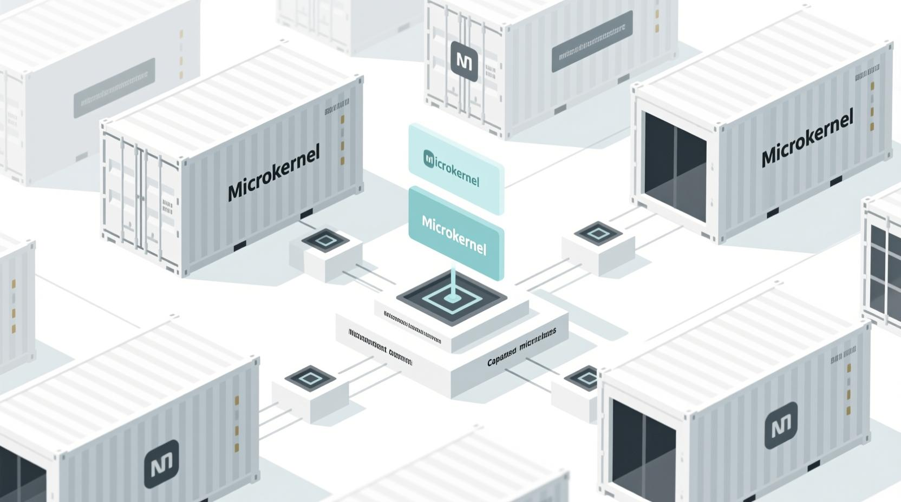
Docker vs. MicroCore: Architectural Differences
MicroCore Containers: Minimal & Isolated
Leverages a minimal microkernel where system calls are routed via IPC to independent microservices. Features lazy-loaded micro-FS and user-space networking for robust isolation.
Minimal microkernel
IPC-routed system calls
Stronger security isolation
Traditional Docker: Shared Kernel
Utilises the host's monolithic Linux kernel, with direct system calls. Employs OverlayFS and kernel-managed networking, leading to a large attack surface due to shared kernel state.
Shared host kernel
Direct system calls
Weaker security boundary

Slide 10
Business Benefits
Enhanced Security
Optimised Resources
Improved Scalability
Regulatory Compliance
Isolated privilege domains significantly reduce attack surface, crucial for protecting sensitive financial data and preventing regulatory penalties.
Modular runtime eliminates bloat, enabling efficient use of computing resources for high-frequency trading and real-time analytics.
Reduced cold start latency allows rapid scaling essential for handling unpredictable market conditions and peak trading volumes.
Enhanced isolation and security features help meet stringent requirements for data protection and operational resilience.

Slide 11

The Future of Containerisation
MicroCore Containers represent a paradigm shift in software deployment, combining the efficiency of unikernels with the flexibility of traditional containers whilst maintaining developer usability.
3x
70%
90%
Faster Startup
Smaller Footprint
Attack Surface
Reduced cold start latency
Memory and disk reduction
Reduction in vulnerabilities

Slide 12
Thank You

